Slide 1


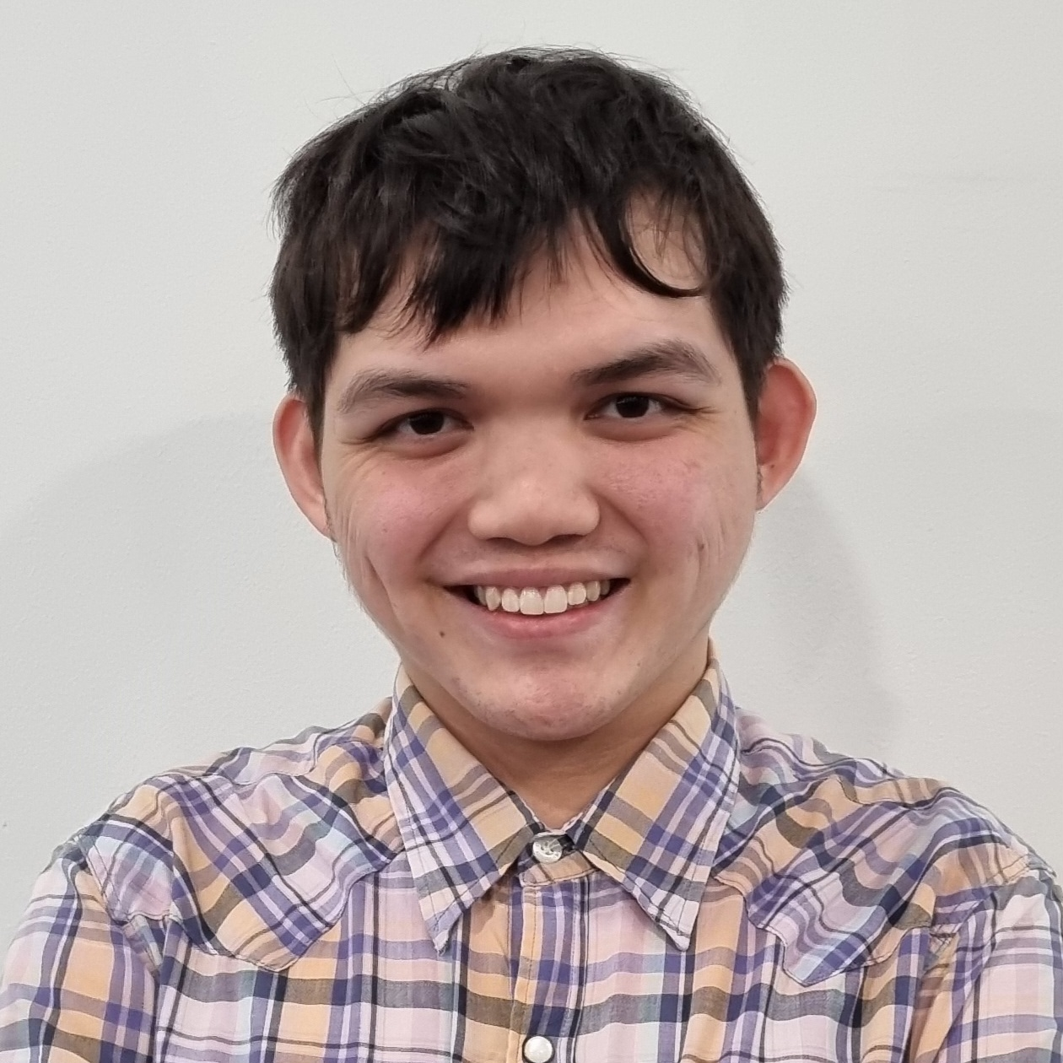
TOMOWORK GOAL SETTING WORKSHEET
NAME
Trevor Lee
INSTITUTE
Nanyang Polytechnic
GOAL START DATE
20 MARCH 2023
GOAL COMPLETION DATE
1 JUNE 2023
MY CAREER GOAL IN _3_ YEARS
WORK
Full-time job in Digital Marketing/F&B as a cook or pastry chef
LEARNING
Either to further my studies in media in internship or university OR attend food cooking courses
ACTIVITIES
Cooking and baking with my family and share with them and my friends, and practice picture/video editng skills
5 THINGS I WANT TO ACHIEVE FROM TAP (Please include more than 1 soft skills)
ACTION THAT WILL HELP ME TO REACH MY GOAL
REVIEW
(REVIEW BY 31 MAY MORNING)
1 | Improve on my CV and Portfolio
2 | Be a good team player & communicator
3 | Time management
4 | Pursue in Media & Digital Marketing
5 | Improve my interview skills to increase my employability
1 | Search for help from facilitators and friends to help me with my CV
2 | Work on my time management
3 | Be involved and help my team
4 | Practice with my friends and facilitators on interview skills
5 | Get along well with everyone
1
2
3
4
5
COMMENTS FROM FACILITATORS

